Slide 1


Slide 2


DRONE FOR CLEANING WINDOW PANNELS
Final Year Project Synopsis
Submitted by
ROLL | NAME
2401730020 | ISHU TANWAR
2401730113 | RANDEEP KAUR
Notes:
New Courses replaced with New Programmes

Slide 3
INDEX
TOPIC
IDEA
PROBLEM
PROJECT DISCRIPTION
ABSTRACT
INTRODUCTION
METHODOLOGY
IMPEMENTATION
COMPONENTS
KEY FEATURE
RESULT
CONCLUSION

Slide 4
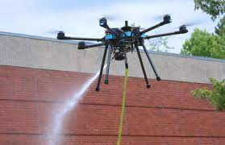

idea
Our idea is clean window of high building by the drone
Just like that
Notes:
New Courses replaced with New Programmes

Slide 5
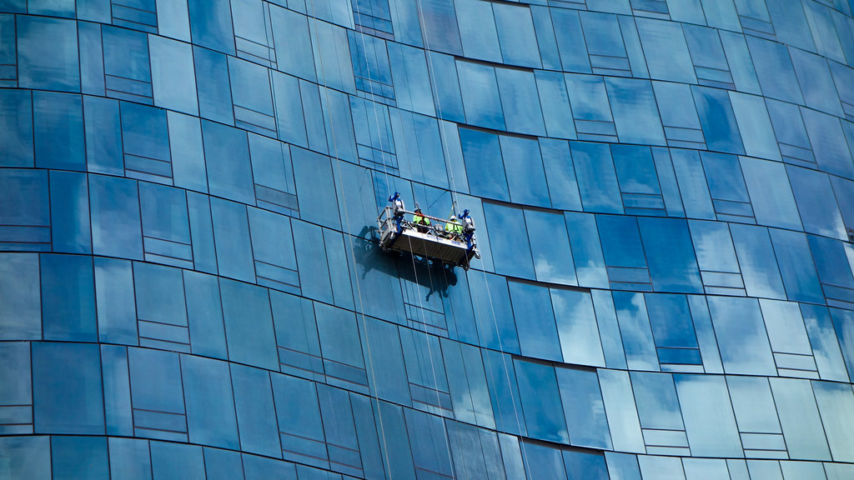
problem
Maintaining a clean living and working environment is an important means to ensure people’s quality of life. As the height of the building increases, the traditional method of cleaning windows by human workers not only takes a long time, but also brings the risk of falling off. It is necessary to replace human workers with robots for carrying out such heavy-duty and dangerous work.
Notes:
New Courses replaced with New Programmes

Slide 6
ABSTRACT
Cleaning high-rise window panels is a risky and labor-intensive task that traditionally requires human workers to operate at dangerous heights. This project proposes a drone-based solution to automate the window-cleaning process, increasing safety and efficiency. The drone is equipped with a cleaning system comprising a water spray module and a rotating brush, along with sensors to maintain a fixed distance from the window surface. Controlled by a microcontroller, the system activates the cleaning mechanism only when the drone is near the window, ensuring precise operation. The prototype demonstrates the potential of unmanned aerial vehicles (UAVs) in maintenance applications, offering a safer alternative to traditional window-cleaning methods.

Slide 7
INTRODUCTION
The rapid urbanization and growth of high-rise buildings have made the cleaning and maintenance of glass window panels a significant challenge. Traditionally, this task is performed by workers using suspended platforms or scaffolding, which not only involves considerable labor but also poses serious safety risks. With the rise of automation and advancements in drone technology, there is a growing opportunity to develop safer, more efficient alternatives.

Slide 8
Methodology
The project aims to develop an aerial cleaning system using a drone to clean high-rise window panels, reducing human risk and increasing efficiency.Key Steps: 1. Problem Identification • Manual window cleaning is dangerous, especially for skyscrapers. • There’s a need for a safer, automated, and efficient method. 2. Design Concept • A quadcopter drone equipped with a cleaning mechanism (e.g., spray + brush). • Ultrasonic sensor for maintaining proximity to the window. • Gyroscope/IMU (e.g., MPU6050) for stability. • Manual or semi-autonomous flight control. 3. Component Selection • Frame, motors, ESCs, flight controller (or Arduino for prototype). • Water pump, spray nozzle, cleaning brush. • Distance sensor (ultrasonic) for surface detection. 4. Cleaning Mechanism • A mini water pump sprays liquid on the surface. • A rotating sponge/brush scrubs the panel. • Optionally, suction or fan modules for stable hovering near glass. 5. Control System • Arduino or Raspberry Pi to control cleaning logic. • PID stabilization or manual flight. • Sensor integration for distance and orientation feedback.

Slide 9
IMPLEMENTATION
The implementation of the drone-based window-cleaning system involves integrating mechanical, electronic, and software components to work together for safe and effective cleaning. The following describes the process in detail:1. Hardware Components • Drone Frame: Lightweight quadcopter frame capable of supporting the weight of cleaning attachments. • Brushless Motors + ESCs: For drone lift and maneuverability. • Flight Controller: Manual (RC) or autonomous control via ArduPilot/PX4 or basic Arduino stabilization. • Power Supply: 11.1V 2200mAh Li-Po battery to power flight and cleaning systems. • Ultrasonic Sensor (HC-SR04): Measures distance from the wall/window to maintain optimal cleaning range (10–15 cm). • MPU6050 (IMU): Gyroscope and accelerometer for balance and stability feedback. • Mini Water Pump + Spray Nozzle: Sprays water or cleaning fluid onto the surface. • DC Motor + Brush Head: Rotating brush or sponge wheel for scrubbing the panel. • Relay Module: Controls high-current components (pump, brush) via microcontroller. • Microcontroller: Arduino Uno or Raspberry Pi to process sensor inputs and control outputs.

Slide 10
Project Description
Drones used for washing windows have to carry more payload thus, multi-rotor configuration is used. By increasing the number of rotors more payload can be carried. 12 rotors are used in this drone to achieve smooth flight and good payload lifting capability. These drones are equipped with allowing the pilot to control and track the cleaning process.
For cleaning the windows, the drone is equipped with a sprayer and cleaning foam or sponge.
The sprayer is connected to a hose through the water is supplied continuously.
An independent power supply is given by the external power source so that the drone can fly for a longer period of time. Thus, it reduces the weight of the drone by not carrying batteries.
Notes:
New Courses replaced with New Programmes

Slide 11
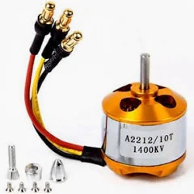
components
Brushless motors
These motors are less in weight and maintenance is also less when compared to conventional DC motors. Low KV rating motors are used since they don’t need to fly faster.
Notes:
New Courses replaced with New Programmes

Slide 12
Propellers
Low pitch and High diameter propellers are used to achieve smooth flight and larger lifting capability.
Frame: Frames are made using materials like carbon fiber and glass fiber which is having a high strength to weight ratio. It is the major part which holds all the other parts together.
Flight Controller Board: It consists of a micro-controller and various sensors like gyroscope and accelerometer which makes the drone to perform the desired task without any error.
Electronic Speed Controller: It is used to control the speed/RPM of the motors based on the input given by the pilot.
Notes:
New Courses replaced with New Programmes

Slide 13
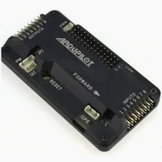
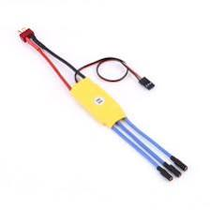

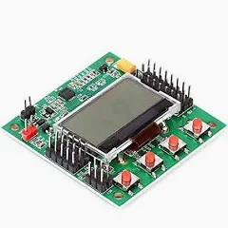
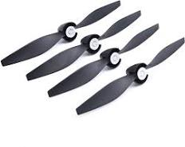
Flight Controller Board
Electronic Speed Controller
Propellers
Frame Drone

Slide 14
Key Features
Automatic Cleaning.
Safety Features.
Efficient Cleaning.
Remote Control.
Efficient Water Usage.
Compact Design.
Design
our drone design is ready .

Slide 15
THANK YOU

